Slide 1

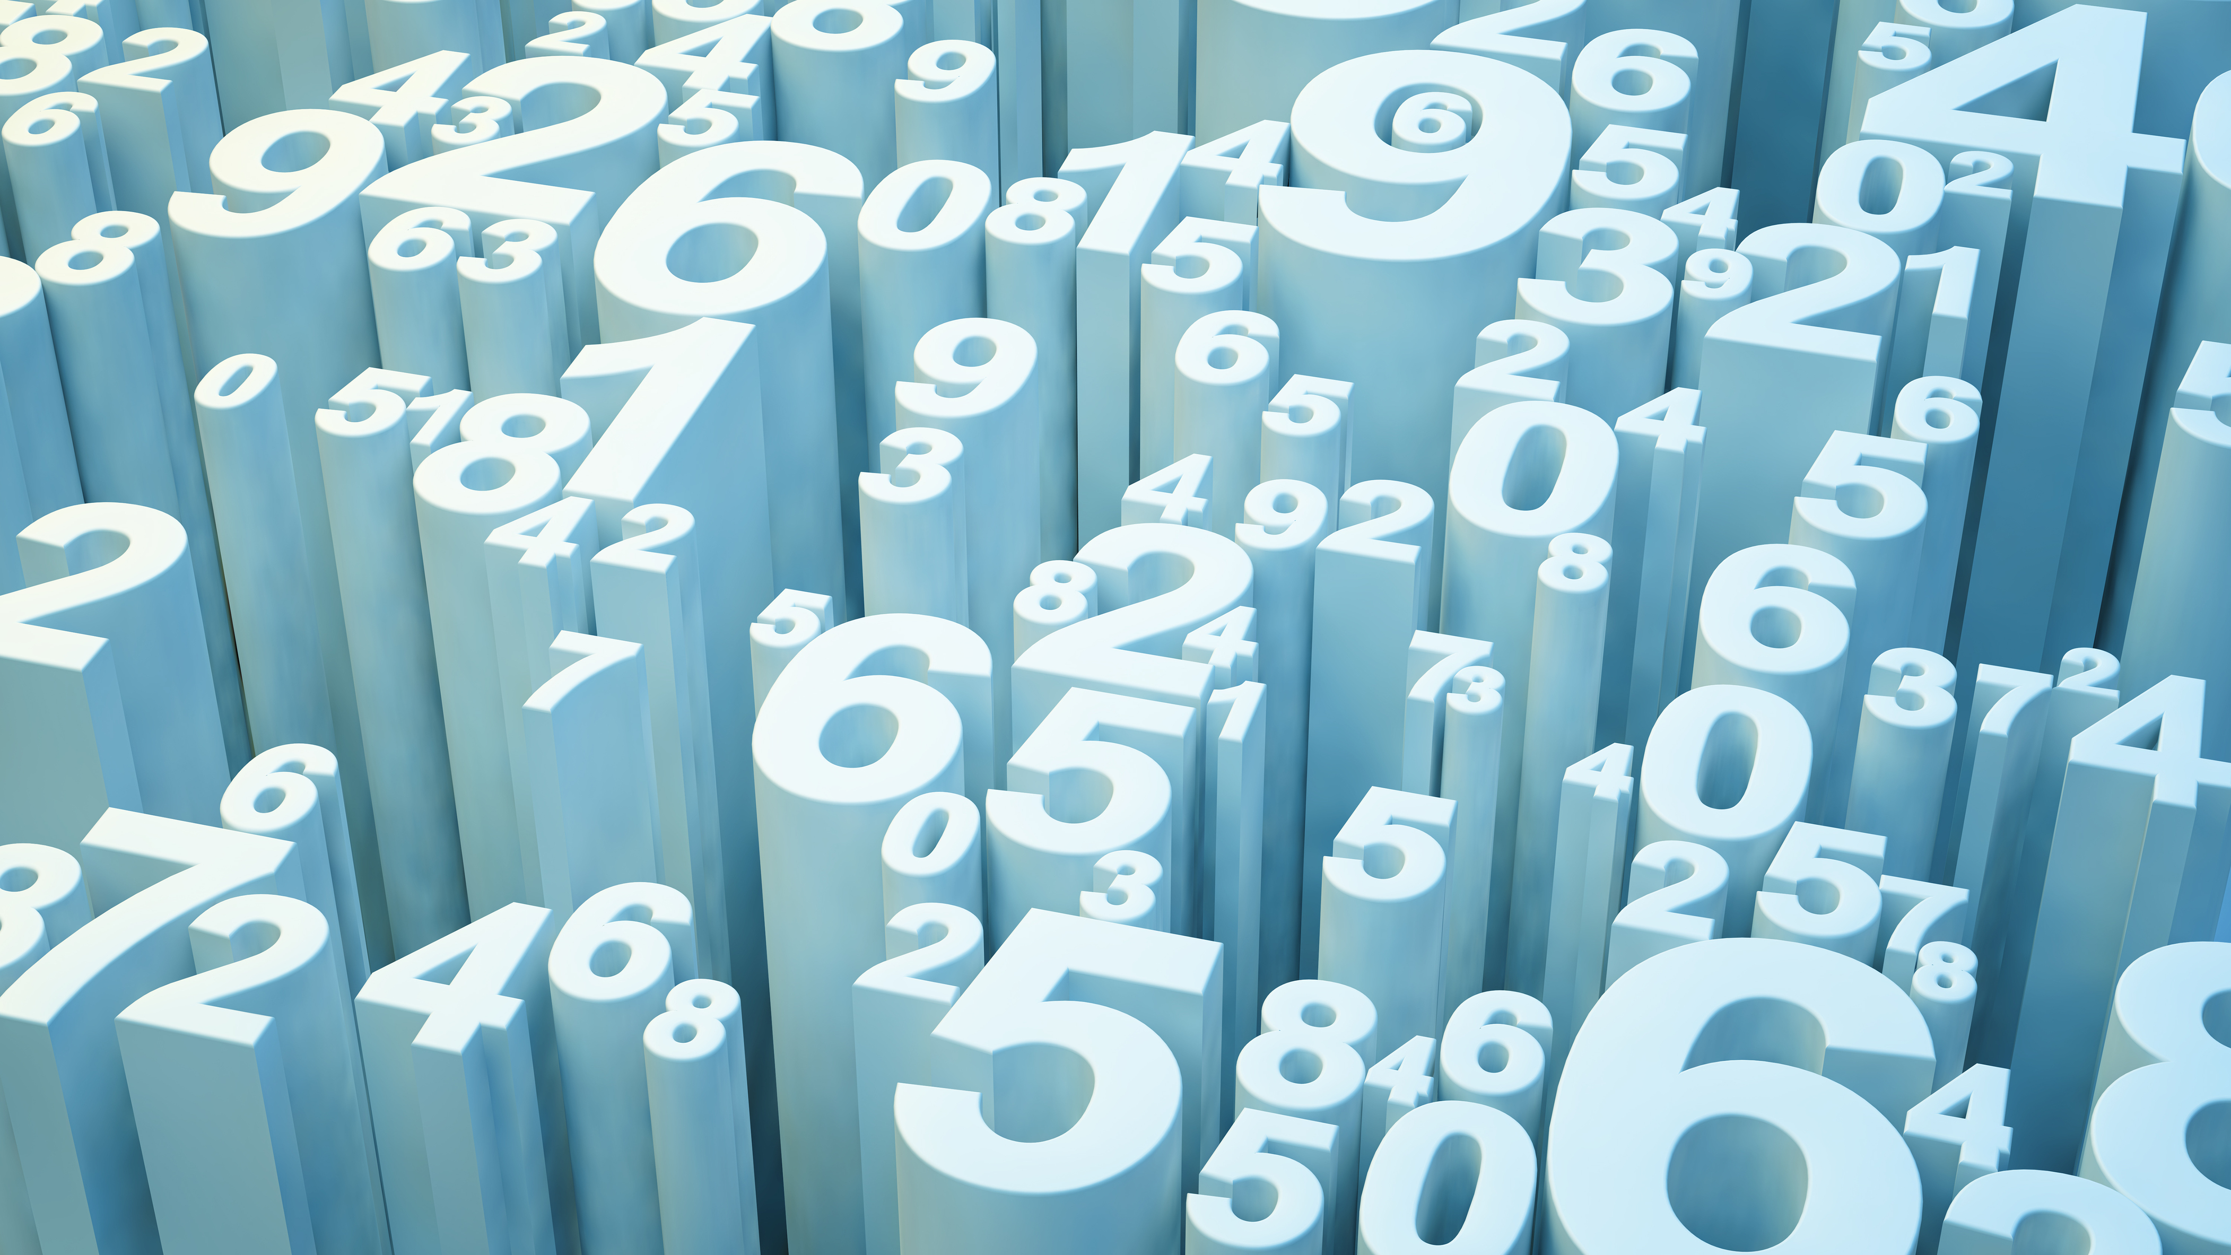
Quantitative Analysis
Amrita Prithiani
Austin Means

Slide 2
Overview of project & project goal
This project is about providing a quick short term analysis of any stock chosen by user. The user will be able to compare between any number stocks and can also compare against the S&P.
The goal is to provide information to user so they can make investment decision. This project do not make any prediction it just provide information based on historical stock data.

Slide 3
Data collection, cleanup & exploration
For this project yahoo_fin api has been used.
Yahoo_fin is a Python 3 package designed to scrape historical stock price data.
while working on this project, we gathered the data from yahoo_fin to pandas data frame. Our data was ready for analysis after we cleared up missing information.

Slide 4
The approach taken to achieve the project goal
The user first enter the stocks which they want to get analysis done.
Next step is to select an options from the list item given. Every item list has some sort of information. The list is divided into thee parts
The general information about stocks
Technical analysis
Fundamental analysis

Slide 5
Result of Analysis
For our example we have chosen for stocks:
NVIDIA Corporation provides graphics - NVDA
Ford Motor Company designs - F
Unity Software Inc. - U
Alaska Air Group, Inc. – ALK
Comparing against s&P500 -SPY

Slide 6
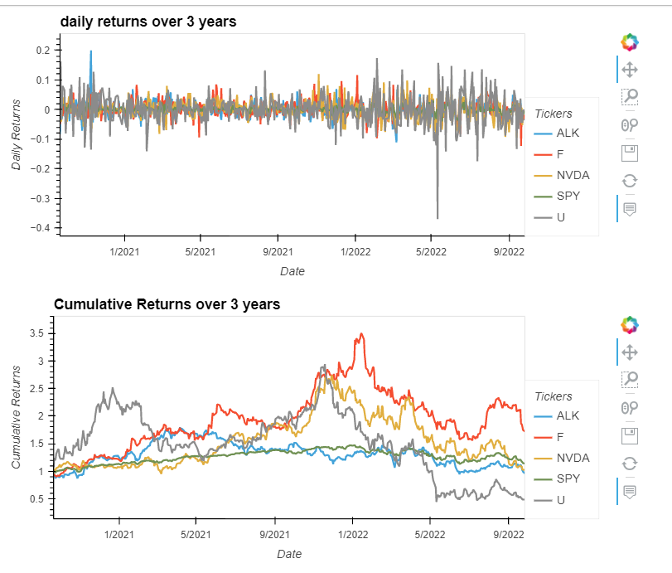
Technical Analysis
We picked option D on the item list to get stocks price performance against S&P 500.
As per cumulative returns chart, except Unity software inc all three stocks performed above s&p.
Ford seems to performed well of all four stocks
Unity software inc had a fluctuating performance where as Alaska stayed closed to s&p 500
NVDA had a its own peak in 2022.

Slide 7
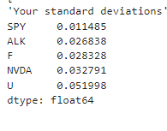
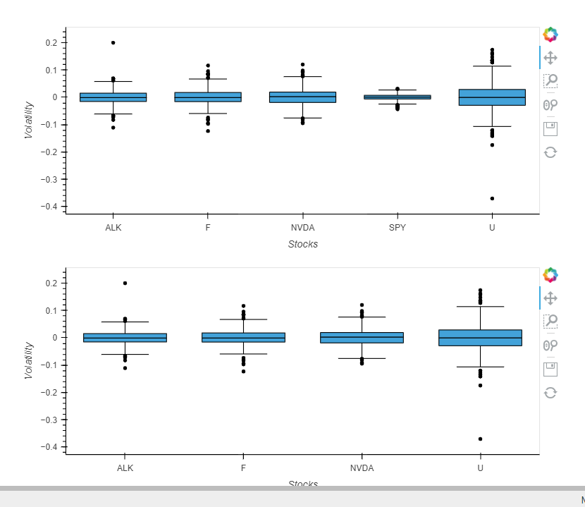
Technical Analysis
SPY 0.011485 ALK 0.026838 F 0.028328 NVDA 0.032791 U 0.051998
SPY 0.011485 ALK 0.026838 F 0.028328 NVDA 0.032791 U 0.051998
Next, we picked option E to get stocks volatility as compare to s&p 500.
In our example of four stocks the standard deviation show how fluctuating are stocks.
As per the analysis, Unity software inc remain highly volatile whereas, rest of the stocks are almost same in volatility.

Slide 8
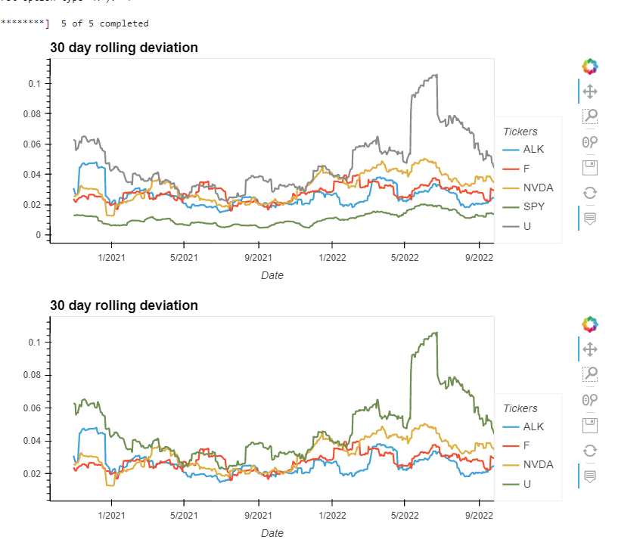
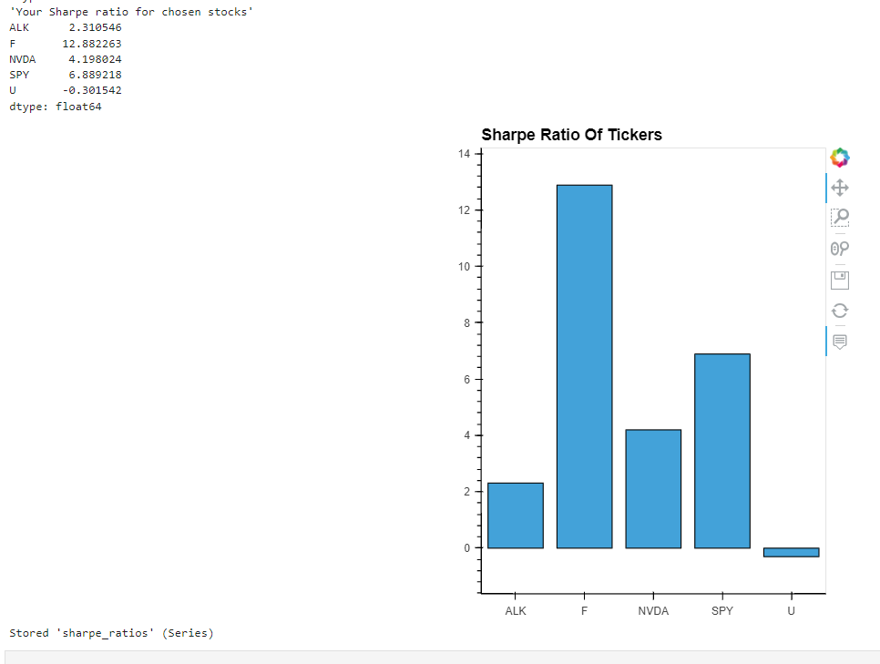
Technical Analysis
Next we are going to measure finance
risk and return on risk. More volatile the stock the more risk.
As per the moving average,
Unity software seems to be more risky stock. Ford and Alaska seems to have constant level of risk.
Whereas, the Sharpe ratio assesses risk and reward by measuring the excess return for the risk that someone assumes when investing in the asset.
As per the sharpe ratio, Ford seems give better return for risk taken then the rest of the stocks

Slide 9
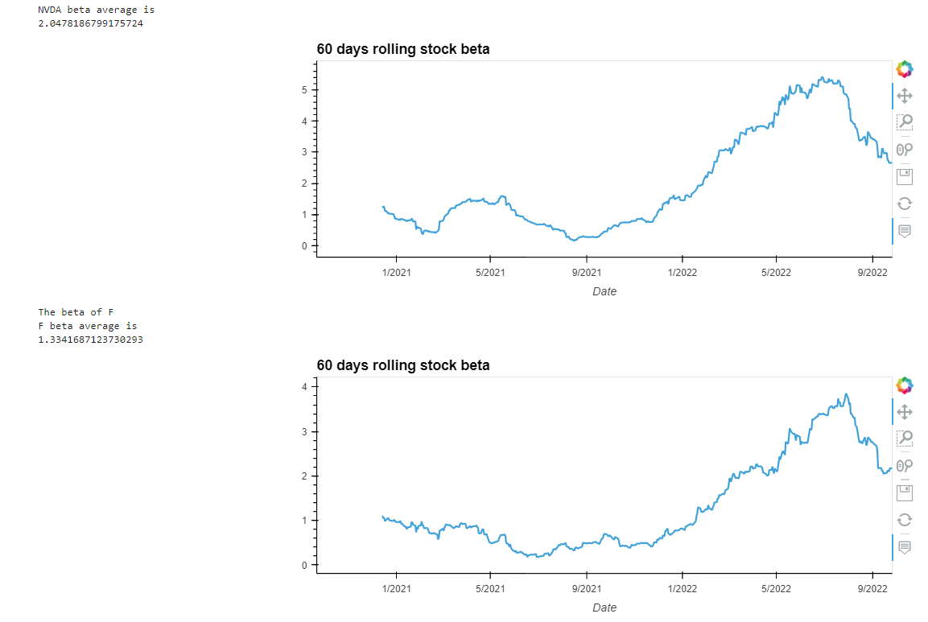
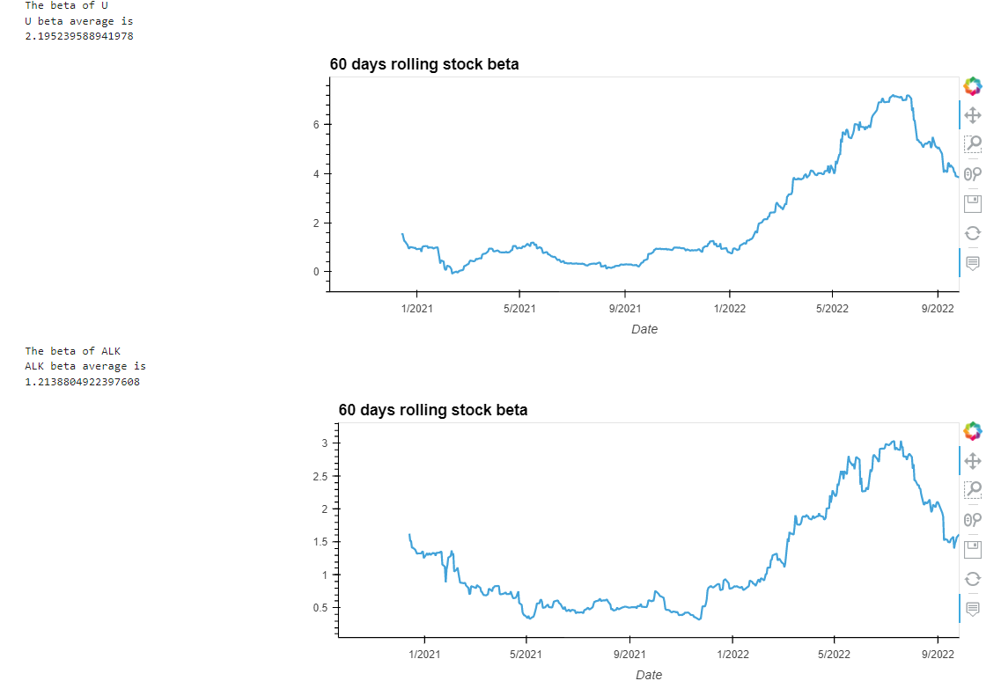
Technical Analysis
The beta measures how much an asset's return value is likely to change relative to changes in the overall market’s return value.
60 day rolling stock beta
NVDA- 2.05
F-1.33
U- 2.40
ALK- 1.21

Slide 10
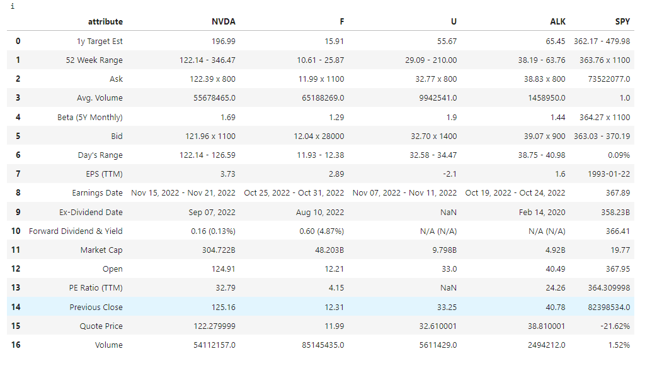
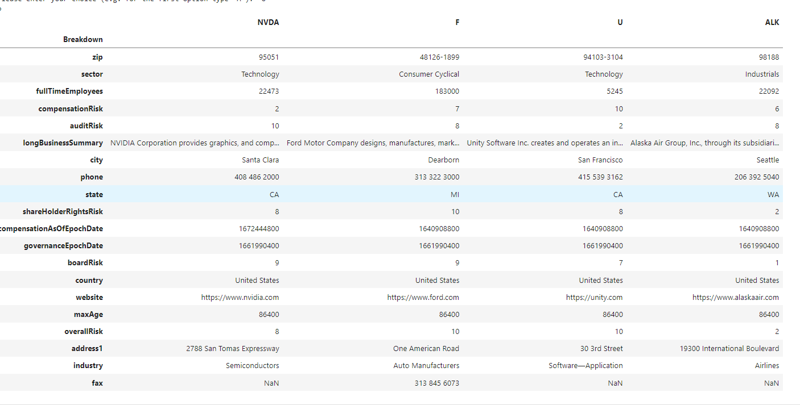
Fundamental Analysis
fundamental data table.
income statements for chosen stocks
balance sheet for the chosen stocks.
cash flow statements for chosen stocks.
book ratio of stocks
analyst information
company information

Slide 11
Next step
Our project is good for short term analysis. Next step will be to enable user to enter time period for which they want to run analysis.
Code can be more simplified so that user can get information in few clicks.
More technical analysis need to be added such as candlesticks plot to show patterns in the data.

